Slide 1

McAllister & Quinn
CAPTURE
Research Universities Practice Services Overview

Slide 2
Key Takeaways
NSDU is a land-grant, R1 EPScoR University with two large NSF EPScOR grants
Top NDSU Research Strengths: Agriculture & Food Systems, Engineering & Materials Science, Health and Biomedical (cancer, Parkinson’s), Energy & Sustainability (biofuels, hydrogen power, and reservoir management)
Heidi Grunwald started her role as interim VPR in August 2025 – search for new VPR underway. Former Role: Heidi held senior research leadership positions at Temple University.
NDSU has Lewis Burke on retainer at $50K per quarter since 2022.
NDSU has an interim President (Rick Berg) – search for new president underway.
No federal relations office – only a state office representation.
None of the Congressional Delegation have secured earmarks for NDSU in FY24 or FY26

Slide 3
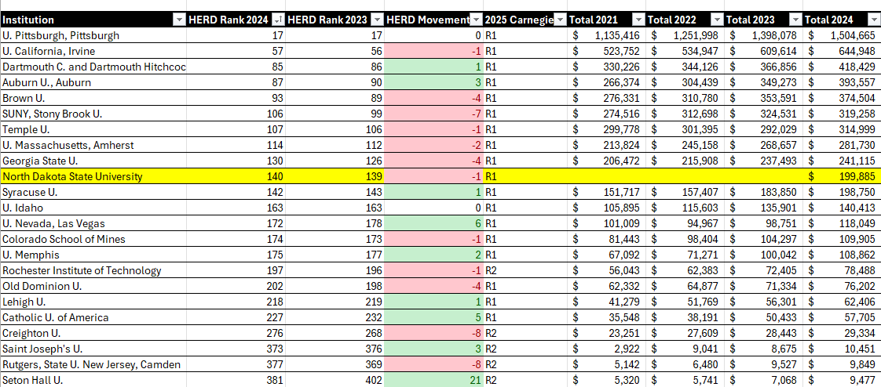
Carnegie and HERD Rank Benchmark w/ RUP Clients
Notes:
Build this out as a table – plug this into copilot to build out the table from an image

Slide 4
Summary of Research Strengths/Profile
NDSU reached a new milestone with $199 million in research expenditures in the most recent fiscal year (FY24)
Stated research areas of focus: agriculture, cybersecurity, energy and water security, materials science, life sciences, statewide presence that includes 7 research and extension centers (no federal reps)

Slide 5
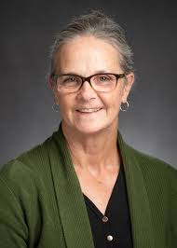
Interim Vice President for Research, Heidi Grunwald
Bio
Background – launched faculty development programs at NDSU & passionate about research development
Education/Expertise: She earned her doctorate in higher education from the University of Michigan and holds advanced degrees in statistics and mathematics education.
Heidi started her role as interim VPR in August 2025
Former Role: Heidi held senior research leadership positions at Temple University, where she directed the Institute for Survey Research and co-founded Legal Science, LLC. She has more than two decades of experience in research development, public health law and data-driven policy evaluation.
Notes:
Sources:
https://www.ndsu.edu/research/office-vice-president

Slide 6
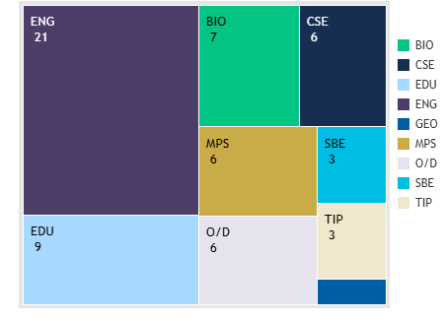



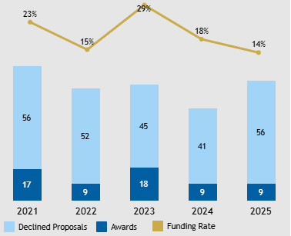


NSF Performance
Strategic Intelligence
Awards by Directorate
20% funding rate; slightly above NSF 2025 avg. of 19%
ENG is their leading directorate
Largest Active Awards
RII-Track 1 - $20M
NSF Engines Award - $15M
NSF I-Corps Hub - $14M
RII-Track 2 - $6M
MRI Track 2 - $4M
Notes:
Sources:
Add PDF NSF
Peers:

Slide 7
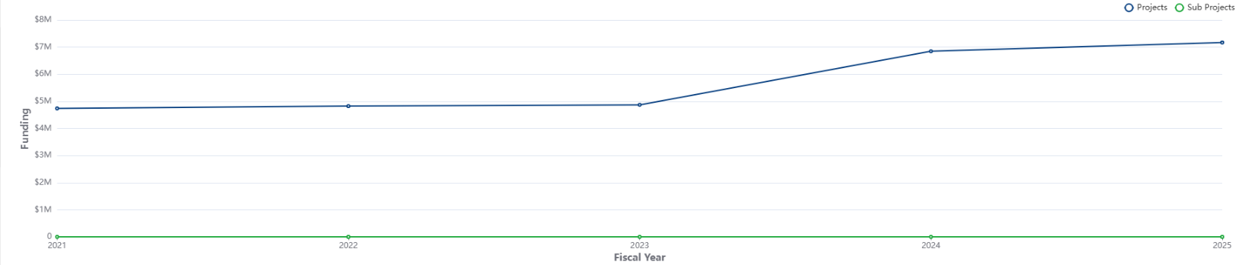
NIH Reporter
Strategic Intelligence
FY21-25, 65 total projects
Small but positive funding trajectory
Project Funding by Fiscal Year

Slide 8
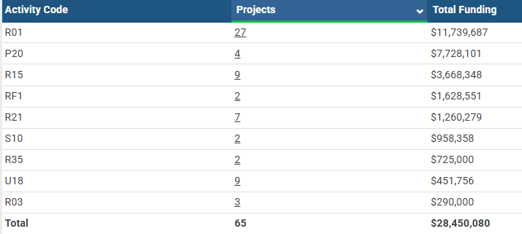
NIH Reporter
Strategic Intelligence
Variety of activity codes
Project Funding by Activity Code

Slide 9
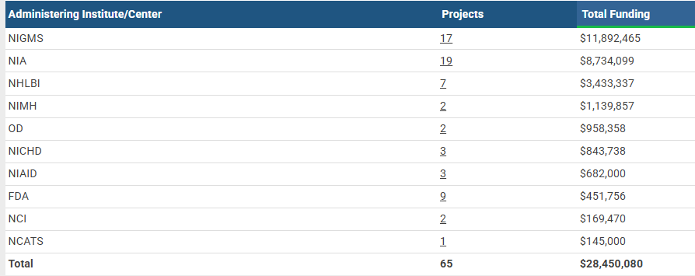
NIH Reporter
Strategic Intelligence
NIA and NIGMS leading ICs
Project Funding by Administering Institute

Slide 10
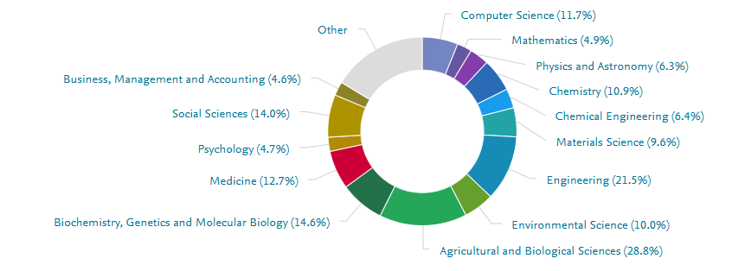
Scholarly Output (SciVal)
Strategic Intelligence
Scholarly output rose from 1,181 publications in 2020 to 1,295 in 2024, an increase of 10%.
The overall Field-Weighted Citation Impact (FWCI) mean is 1.78, which is 78% above the world mean of 1.00
Scholarly Output by Subject Area
Source: SciVal® database, Elsevier B.V., http://www.scival.com (downloaded on [February 2026]).
Notes:
Just a screenshot of the publications by subject area.

Slide 11
Recent Press
https://www.ndsu.edu/news/grunwalds-faculty-development-ndsu-helping-boost-nsf-competitiveness
https://www.ndsu.edu/news/ndsu-interim-vice-president-research-and-creative-activity-named
https://www.cramer.senate.gov/news/press-releases/senator-cramer-co-leads-bipartisan-effort-to-protect-water-infrastructure-funding-from-earmarks

Slide 12
Lobbying Intelligence
NDSU has Lewis Burke on retainer at $50K per quarter since Q3 2022.
NSDU has another firm (Capgov LLC) on retainer, no activity or retainer amount reported.
Specific lobbying issues (Budget): H.R. 5342, S.2354, FY 2026 Commerce, Justice, Science, and Related Agencies Appropriations, Issues pertaining to NSF TIP and EPSCoR. H.R. 4016, S.2572, FY 2026 Defense Appropriations, Issues pertaining to coatings and materials research, cybersecurity, and hypersonics. Issues pertaining to the Northern Great Plains Regional Authority.Issues pertaining to agriculture technologies, on-farm research, and agriculture policy research.
Specific lobbying issues (Defense): H.R. 3838, S.2296, National Defense Authorization Act of FY 2026, Issues pertaining to coatings and materials research.
Specific lobbying issues (Science): Issues pertaining to agriculture technologies, on-farm research, and agriculture science workforce pipelines.

Slide 13
Lobbyists at Lewis Burke
Named Lobbyists at Lewis Burke
Christina Laridaen
Bridget Krieger
Otto Katt - Legislative Fellow, Office of Rep. Phil Roe
Sharon Eshelman - Senior Advisor-DHS Office of Legislative Affairs; Subcommittee Staff Director-House Committee on Oversight and Government Reform; Special Assistant-DHS ICE; Deputy Associate Director-WH HS Council; Staff Assistant-WH Office of Legislative Affairs
Notes:
Sources:

Slide 14
Congressional Delegation
Representative: Julie Fedorchak (R) house committee on energy and commerce (no earmarks in FY24 or FY26 for NDSU)
Senator: John Hoeven (R) senate committee on agriculture nutrition & forestry, senate committee on appropriations, senate committee on energy and natural resources, senate committee on Indian affairs (no earmarks in FY24 or FY26 for NDSU)
Senator: Kevin Cramer (R) (no earmarks in FY24 or FY26 for NDSU) – Cramer critical of to earmarks.

